Slide 1
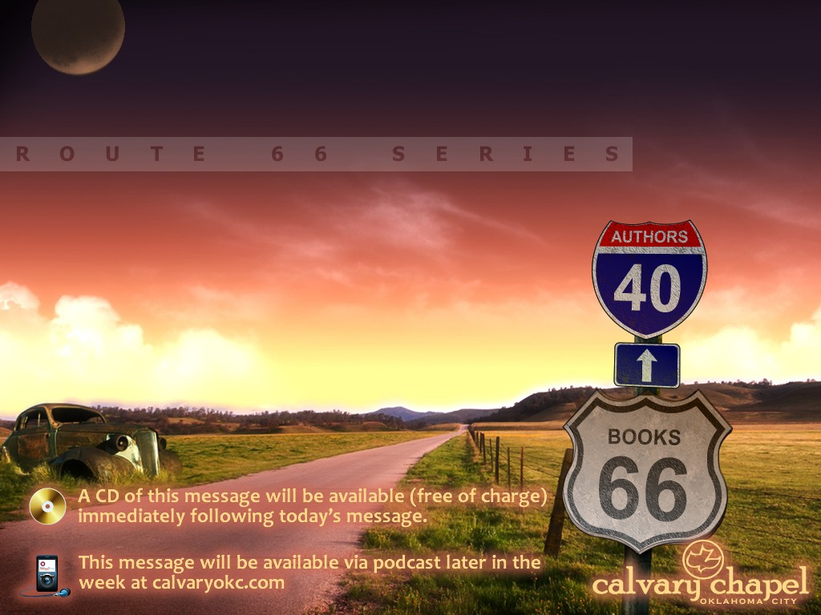
COLOSSIANS

Slide 2
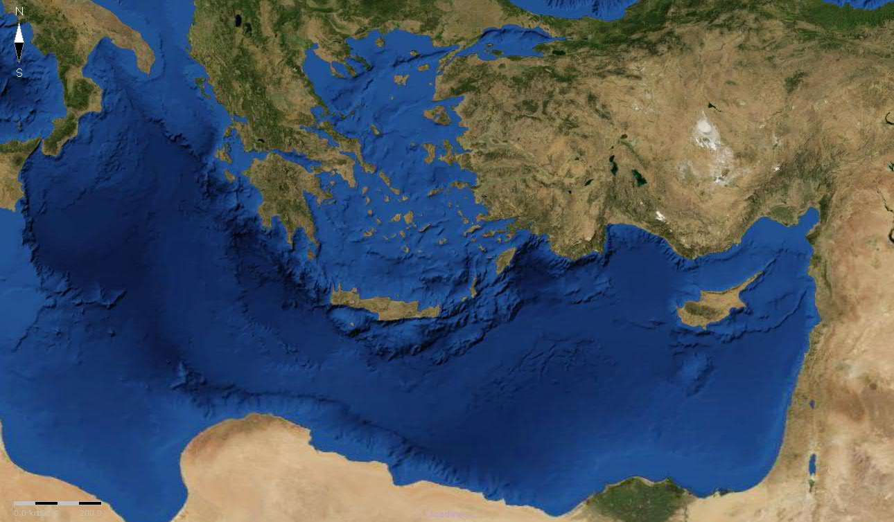
COLOSSIANS
Hieropolis
Laodicea
Colosse

Slide 3
COLOSSIANS
Understanding ~ sunesis – a flowing together

Slide 4
COLOSSIANS
prototokos ~ protos (first) + tiktō (to bring forth)
Image ~ ikōn

Slide 5
COLOSSIANS
Then he fell to the ground, and heard a voice saying to him, "Saul, Saul, why are you persecuting Me?"
Acts 9.24

Slide 6
COLOSSIANS
For where your treasure is, there your heart will be also.
Matthew 6.21

Slide 7
COLOSSIANS
"How you stand depends on where you sit.”
Hubert Humphrey

Slide 8
COLOSSIANS
"There is no power in dull, listless praying. If there is no fire on the altar, the incense will not rise to God."
Warren Wiersbe

Slide 9
COLOSSIANS
Redeeming the time ~ idiom for corner the market

Slide 10
COLOSSIANS
Laboring fervently ~ agōnizomenos
agōn, to labor to the point of pain + menos, to remain

